Slide 1
Module 1: Mathematical Argumentation
Part 2: Mathematical Argumentation in the Classroom

Slide 2
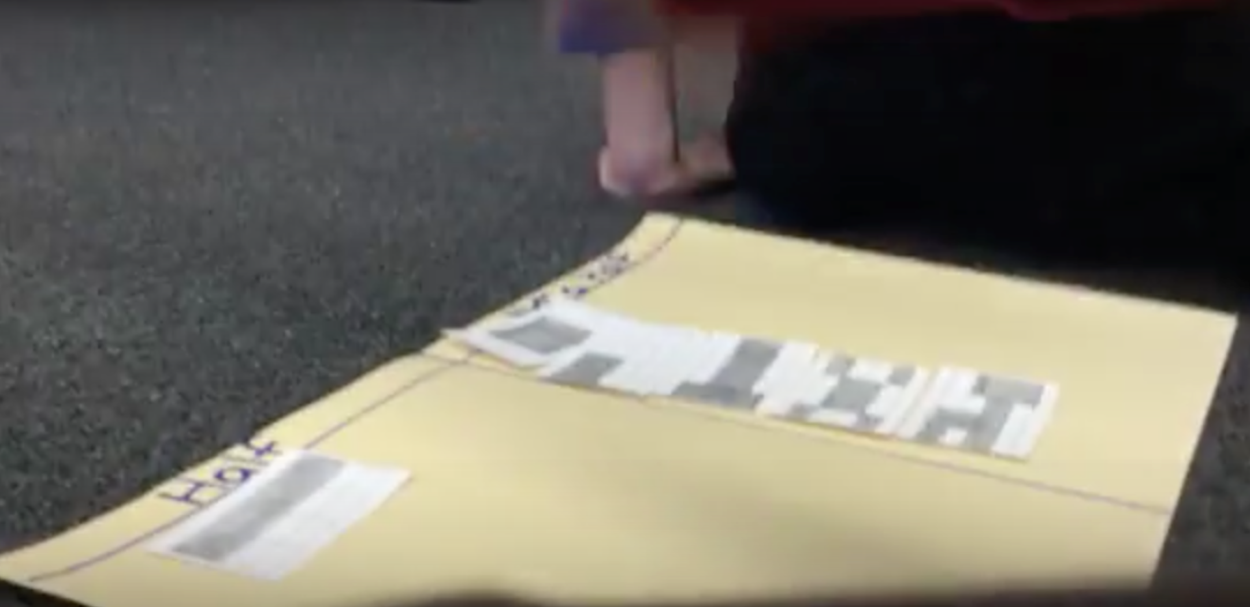
Review of Module 1 part 2
Module 1: Part 2
Teachers on the value of argumentation
Video– how might argumentation support conceptual understanding?
YOU ARE HERE!
Secondary task with student work
Connecting to practice
Notes:
…
…. For each clip, we have some guiding questions to help focus your reflection and conversation
Some commentary by us about the videos
Finally, there is a set of student work samples from HS students – along with some commentaries – for those of you who are secondary teachers. The video is relevant for all levels, but it’s also nice to see some of the mathematics your own students might work on.
We conclude with some questions that might help you link argumentation to your practice and start
ORIGINAL BULLETS ON SLIDES:
Teachers on why they value argumentation in their classrooms
Classroom videos of students engaged in argumentation – how does argumentation support conceptual understanding?
Secondary task with student work
Connecting to practice

Slide 3
Reflection and Link to Your Classroom
What is the role of argumentation currently? What would you like it to be?
What is the purpose(s) currently? What would you like it to be?
Think about the students in your classroom. How might you engage them in argumentation?
How might you incorporate argumentation into your next lesson? Unit?
Connecting to practice

Slide 4
Module 1: Mathematical Argumentation
This concludes Module 1.
Thank you!
Part 1: What is a Mathematical Argument?
Part 2: Mathematical Argumentation in the Classroom
Notes:
Thank you, and good luck as you work to incorporate argumentation more extensively into your classroom. Remember – use colleagues as resources!

